Slide 1
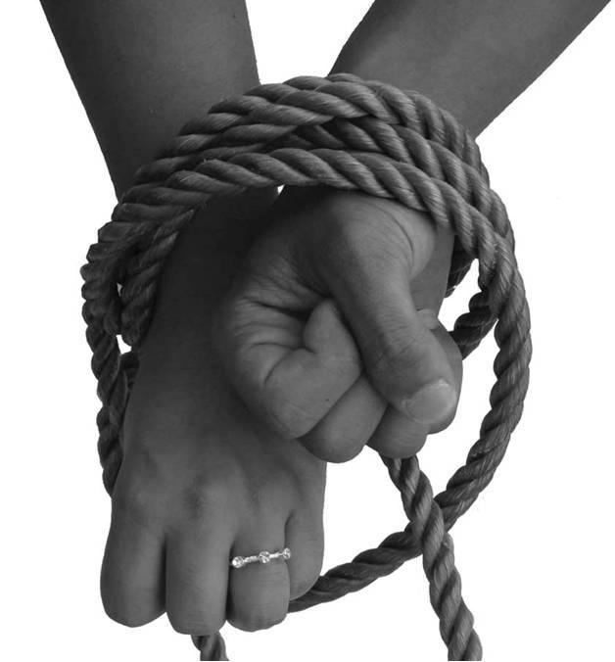
FORCED MARRIAGE AND ‘HONOUR’ BASED ABUSE

Slide 2
Introductions
Sabeena Pirooz – Sky Project Director
Larisa Hunt – Police Lead for ‘Honour’ Based Abuse and
Forced Marriage

Slide 3
‘Honour’ Based Abuse Definition
‘an incident or crime involving violence, threats of violence, intimidation coercion or abuse (including psychological, physical, sexual, financial or emotional abuse) which has or may have been committed to protect or defend the honour of an individual, family and/ or community for alleged or perceived breaches of the family and/or community’s code of behaviour’
NPCC definition

Slide 4
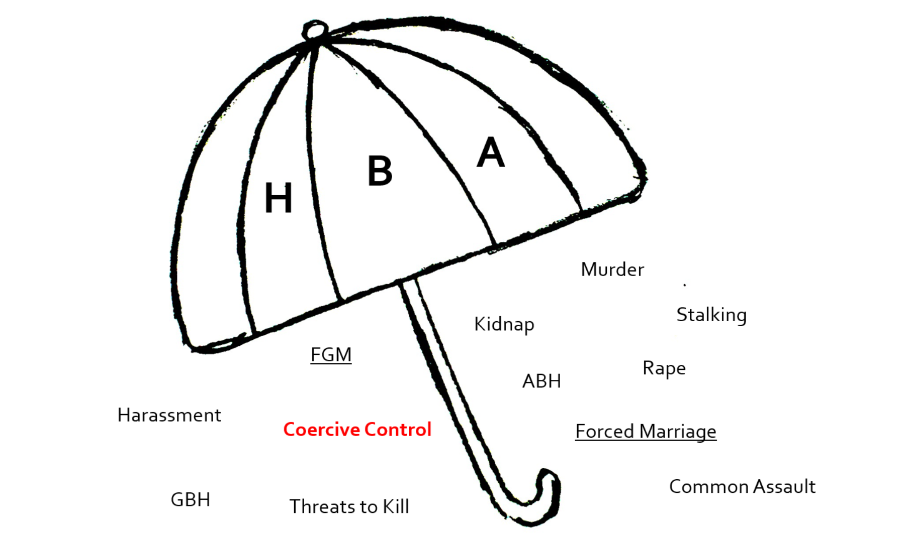

Slide 5
Codes of honour
Victims are conditioned from a very young age as to what is acceptable and what is not acceptable behaviour
Within close knit families and communities, being seen as honourable and having a high social standing is paramount.
Being too “Western” – short hair, wearing too much makeup, clothes which expose your skin, use of drugs / alcohol - inappropriate relationships (including same-sex), defying parental authority – all could be seen as shameful and dishonourable and lead to violence and abuse

Slide 6
Survivors speak!
What is honour……?
“Consists of a learnt complex set of rules that a woman has to follow in order to protect her family’s name and maintain family position”.
“It’s like the weather, you can’t question it … Honour (IZZAT) is there, it’s always been there”
“Honour is the biggest issue in my life”
“With every bad word a reputation can die”

Slide 7
Definition of a forced marriage:
“ A marriage in which one or both spouses do not consent to the marriage and duress is involved.
Duress can include physical, psychological, financial, sexual and emotional pressure.
In cases of vulnerable adults who lack capacity to consent to marriage, duress is not required for a marriage to be forced”
HM Government (2014). Multi-agency practise guidelines; Handling cases
of Forced Marriage.

Slide 8
Misconceptions around forced marriage:
Arranged marriages
Religion
Culture
Effects only women
Effects only Asian communities

Slide 9
Arranged Marriages
In arranged marriages, the families of both spouses take
a leading role in arranging the marriage but the choice
whether or not to accept the arrangement remains with
the prospective spouses.

Slide 10
Forced Marriage and Religion
Forced Marriages cannot be justified on religious grounds;
every major faith condemns it and freely given consent is
a prerequisite of Christian, Jewish, Hindu, Muslim and
Sikh Marriages”
Home Office (2000) The right to choose: Multi-agency statutory
guidance for dealing with forced marriage

Slide 11
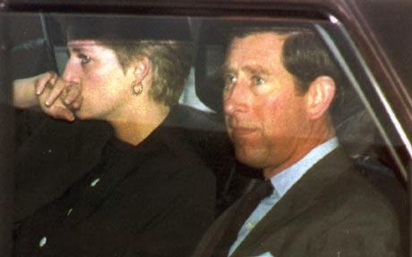
Forced Marriage and Culture
“Forced marriage is not just an Asian issue and to
discuss it as such denies a voice to those from other
communities who have experienced it”
Home Office (2000) A Choice by Right: the report of the
working group on forced marriage
Notes:
SP

Slide 12
Who does it affect?
Sex:
Forced marriage affects both men and women. It is important to recognise that it is not only a female issue
Age:
People of all ages are forced to marry, but statistics show highest rates amongst women and girls aged between 13 and 30
Nationality
This is NOT just a south Asian community issue, we need to ensure all victims are given a voice

Slide 13
Statistics:
Each year, the Forced Marriage Unit encounters:
On average, over 1200 cases are dealt with every year since 2011
In 2020 this figure was down to 759
In 2020, 26% cases concern children under 18. Around 15% involve children aged 15 and under.
Around 21% cases concerning men. This is on the rise.
10% involved victims with mental capacity concerns
Research carried by Dept of Children, Schools and Families’ estimated the ‘national prevalence of reported cases’ of forced marriage in England was between 5000 – 8000

Slide 14
Why do forced marriages take place?
Patriarchal – mainly women but not always
Maintaining ‘honour’ or ‘izzat’
Custom/traditions
Controlling sexuality
Financial gain
Strengthening partnerships
UK residence and citizenship
Providing someone with a carer

Slide 15
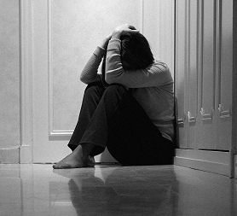
Outcomes of Forced Marriage: Domestic violence and abuse (child) Suicide/Self-harm Depression Sexual abuse Child abuse Female Genital Mutilation Human trafficking 14 ‘honour’ killings a year

Slide 16
Current Legislation
Forced Marriage is a criminal offence!
New offences came into force on 16th June 2014 as part of the Anti-social Behaviour, Crime and Policing Act. A person commits an offence if he or she:
Uses violence, threats or any form of coercion causing another person to enter into the marriage.
Marries someone who lacks the mental capacity to consent to the marriage (whether they’re pressured to or not)
Maximum penalty in criminal court is 7 years imprisonment

Slide 17
Forced Marriage Protection Orders
The Forced Marriage (Civil Protection) Act 2007 allows the Court to make a Protection Order:
The aim of the order is to protect the person who has been, or is being forced into a marriage against their wishes
Exist alongside the new criminal offence.
Anyone can apply
A breach is an offence in its own right
Already have criminal laws to deal with threatening behaviour, assault, kidnap, rape, abduction, threats to kill, theft (of passport), imprisonment and murder

Slide 18
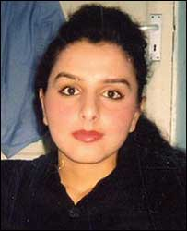
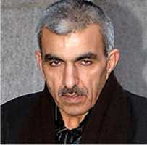
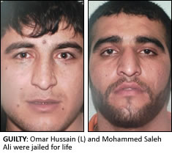
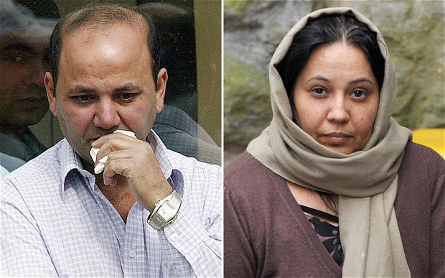
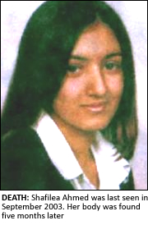

Slide 19
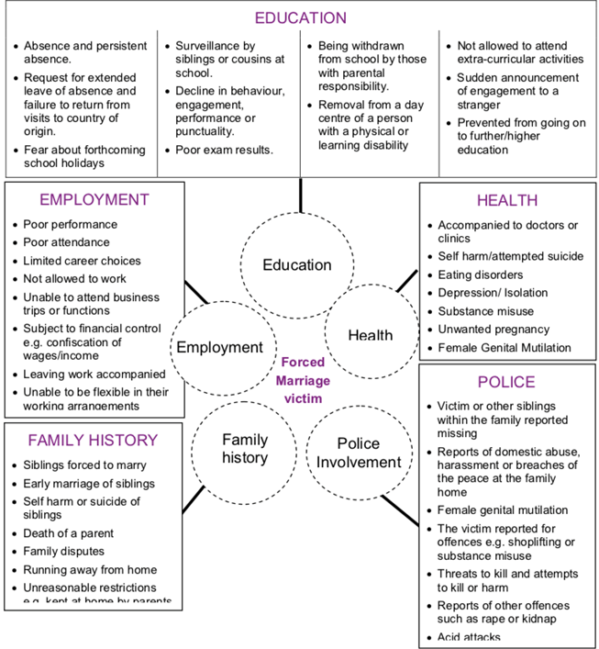

Slide 20
‘one chance rule’ - what you DO:
•Create an ‘open’ and supportive environment
•Arrange for an authorised interpreter if required – consider out of area
•See them on their own where the conversation cannot be overheard.
•Remind them of their rights i.e. right to enter into the marriage with their full and free consent.
•Reassure them that matters will remain confidential unless there is immediate risk to life/a minor
•Consider the need for immediate protection (away from family)
•Contact a trained specialist, SMEs or national helplines
•Safety planning – consider HBA fingerprint and copies of travel documents. HBA markers on police systems

Slide 21
What you DON’T DO:
•Do NOT contact parents/family
•Do NOT try to mediate between families/community members
•Do NOT consider a child is safe by removing the alleged perpetrator from the household – likely to increase risk
•Do NOT be manipulated into breaching victim’s confidentiality – under GDPR/DPA cases cannot be discussed with anyone claiming to be a relative/community member
Do NOT think it is any less serious if there has been no physical violence

Slide 22
Multi-agency Safeguarding
Where there is a risk of harm to adult or child who is at a risk of ‘Honour’ Based abuse and/or Forced Marriage, this should be reported for a multi-agency statutory response.
Safeguarding options are:
1. Moving a victim to a safe location
2. Consider legal options such as Forced Marriage Protection Order (FMPO)
3. If there is a risk of travelling abroad, the police are able to take fingerprints, DNA, photographs and place markers on police systems
4. Agencies can work with the Forced Marriage Unit and Foreign Commonwealth Office to repatriate British Nationals.

Slide 23
Local and National Links
Local Links – Bristol
1. Sky Project – for training needs
www.skyproject.org.uk - contact us at skyproject@hotmail.co.uk Follow us on Twitter @The SkyProject2
2.Police – Larisa Hunt and Punita Bassi or 999 if an emergency
Email: larisa.hunt@avonandsomerset.police.uk
Email: Punita.Bassi@avonandsomerset.police.uk
3. Nextlink – forced marriage and honour based violence specialist
Tel: 0800 470 0280
4. Refugee Women of Bristol – tel: 0117 9415867 https://www.refugeewomenofbristol.org.uk/

Slide 24
National
Forced Marriage Unit – Tel: 0207 008 0151 OOH: 0207 008 1500
Karma Nirvana – Tel: 0800 5999 247
The Sharan Project (charity supporting vulnerable women) – Tel: 0844 504 3231
Asiana Network (emergency accommodation for Asian Women) – 0208 539 0427
IKWRO – Iranian & Kurdish Women’s Rights Organisation – Tel: 0207 920 6460
Respect – Men’s Advice Line – Tel: 0808 8010327
LGBTQI+ - Naz and Matt Foundation – email: support@nazandmattfoundation.org
Southall Black Sisters – tel: 0208 571 9595
Hidayah – charity supporting LGBTQI+ Muslims – Email: info@hdayahlgbt.co.uk
Further reading
- Forced Marriage Unit Multi-agency Guidelines

