Slide 1
Bristol Child Exploitation Collaboration
Project Update February 2022

Slide 2
The Project Team
Harriet Andrew
Project Manager
Emily Kay
Researcher
Olesya Myakonkaya
Service Designer
Chloe Feehan
Peer Influencer
Becky Lewis
BCC
Barnardo’s Innovation Lab
Duncan Stanway
Barnardo’s
Suzanne Taylor
Barnardo’s
Stakeholders
Inc. Health, Police/OPCC, Youth Organisations
Notes:
Myself as PM, Emily who is the researcher and Olesya who is the service designer, she is also completing research interviews and will support Emily with workshops as we move forward into the design space
We are the core group day to day, however we are supported by Barnardo’s Innovation Lab
Service Specialist knowledge from Becky, Duncan and Suzanne
Peer Influencer – as discussed will bring expertise by experience
Other stakeholders from partner agencies including health, police, OPCC, Youth Orgs etc
We are meeting bi-weekly to problem solve and set direction

Slide 3
Strategic Objective
Develop a specialist services model for children who have been exploited or effected by youth violence
Research Question
How can children and young people in Bristol who have experienced exploitation or youth violence be supported to move forwards and have better outcomes?

Slide 4
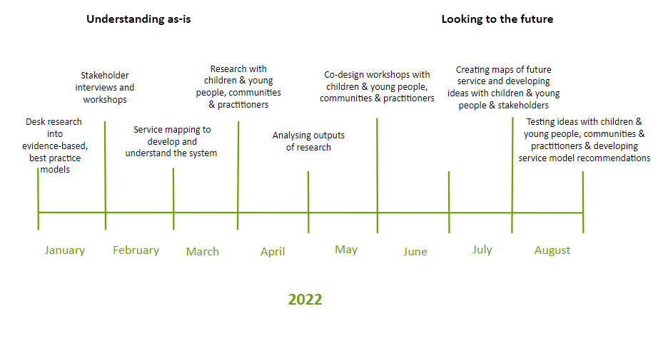
Project Plan

Slide 5
Literature Review
The most successful interventions are holistic and include a combination of the following but there is no silver bullet:
1:1 support such as peer mentoring | Community based interventions | EET | Family support | Training school professionals |Providing opportunities such as football and music clubs | The quality of physical locations is key (e.g. green spaces, street lights etc)
Peer to peer crimes are often overlooked
Language that professionals use can be preventing them from building trust (victim blaming)
Contextual safeguarding is a relatively new practice and sometimes professionals don’t know how to translate into practical steps
Police don’t see YP engaging in group criminal activity as vulnerable and break trust easily
Thresholds are too high - families call services multiple times but often don’t feel heard
Multi-agency approach is a must but needs more operational thought - how to collaborate in practice is not clear
Interventions are overly focused on 1:1 support
Services are split up but often the same child is a victim to various harms (often overlooking opportunities to intervene holistically)

Slide 6
Stakeholder Interviews
Barnardo’s Routes / Barnardo’s BASE
Learning Partnership West
Operation Topaz
Social Care East Central
Social Care South
Safer Options
Barnardo’s Service Manager (Old Market Services)
OPCC
Centre of Expertise and CSA Pathway
Senior Youth Workers (FIF & Safer Option)
Education Inclusion Managers (FIF & Safer Option)
YOT
University of Bedfordshire (Contextual Safeguarding)

Slide 7
HOPES for the project

Slide 8
FEARS for the project

Slide 9
Emerging themes
Need more involvement of health professionals (both in terms of referral and providing interventions)
Need a more collaborative approach between organisations (we are hearing about duplication, not knowing who is doing what, siloes - although there are examples of collaboration working particularly well on particular projects with a joint goal, e.g. Stapleton Road, Weapons in School Pathway)
Lack of data sharing is one of the big obstacles to collaboration (although some good examples of it working well)
Cross-agency collaboration is personality dependent (depends who you get in meetings)
Over focusing on 1:1 support such as peer mentoring and social worker support as opposed to collaborative community interventions
Lack of understanding how to turn contextual safeguarding into practical steps (varied)
Lack of clarity on how to transition to adult services when YP reach 18

Slide 10
Continued..
Lack of EET opportunities for YP who were criminally exploited Difficult to identify harms that are on the horizon/overlook signs of harms that are about to happen (thresholds might be too high for referrals, families, schools etc might not know how to spot red flags…) Services focused on high risk (after harms had occurred) and early intervention - gap for those in the middle?
Pressure on community mentors being a silver bullet but they are very stretched More skill sharing needed between statutory → voluntary organisations Exploitation services split out into CCE vs. CSE, whereas needs for young people often overlap (some upskilling is being done to address this, e.g. Routes workers training in CSE, and Topaz recently expanded to include CCE) The importance of school inclusion is highlighted as a protective factor, it noted by social care that attendance is particularly poor in South Bristol.

Slide 11
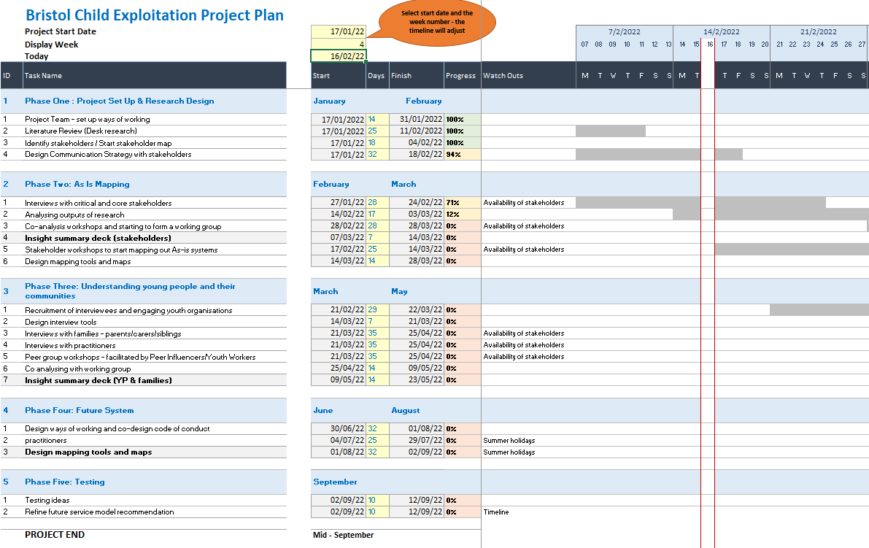
Next Steps

