Slide 1



Child sexual abuse (CSA): Understanding, Recognising and Responding when children tell
Dr Michelle Cutland
Consultant Paediatrician
Clinical Lead Paediatric service The Bridge SARC

Slide 2
Today’s session
Introduction and self care
Child sexual abuse: a hidden harm
Understanding ‘Telling’
Recognising potential signs and indicators of CSA
Receiving and responding to disclosures
Summary

Slide 3
Introduction

Slide 4

Self care
Sexual abuse can be difficult to think about and talk about. Thinking about it and talking about it will affect us all in different ways, at different times.
We know that a high number of people experience child sexual abuse and that many of them have never told anyone about it.
We can assume that there will be people listening to this session today who have either experienced sexual abuse themselves, or who have a family member or friend who has been sexually abused.
It is therefore important that we are;
kind to each other
Respect all opinions
we take time if we need it
we recognise the impact

Slide 5
Child sexual abuse: A hidden harm

Slide 6
ONS Child abuse compendium January 2020
7.5% of adult population - 3.1 million people aged 18-74 - have experienced some form of sexual abuse before the age 16
73,260 sexual offences against children under 18 were recorded for the year ending March 2019 by the police in England and Wales
This does not include CSA image offences which accounted for additional 17,521
CSA is now the most frequent type of abuse that children contact NSPCC ChildLine

Slide 7
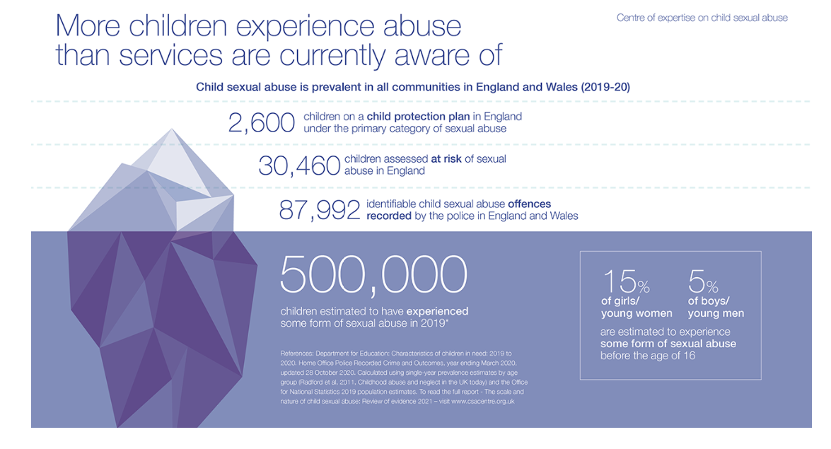
Prevalence of child sexual abuse (csacentre.org.uk)
Notes:
I will get a clearer update of this image

Slide 8
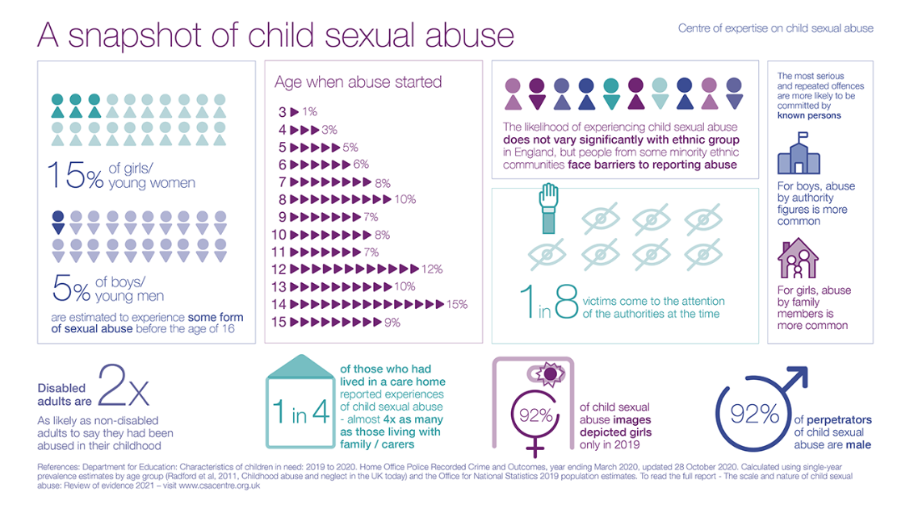
Prevalence of child sexual abuse (csacentre.org.uk)

Slide 9
Why is sexual abuse so hidden?
Think for a minute about something you would not want to tell anyone else – perhaps something you feel bad about, or ashamed of…
Have you ever told anyone about it?
If not, why not?
If you have told someone, who did you tell?
How did you work out who to tell?
How much of what happened did you tell them?
Did you tell them all of the detail at one time? Or in stages?
Did you test them out first to see if they would be supportive?
Did you worry about what they would think of you?
Did you worry about who they may tell?
How would you feel if I asked you to tell me about that thing now?
Notes:
How did you feel when I asked you to write down something you didn’t want to share?
What thoughts did you have about where the exercise was going?
How did you choose what to write? (Did anyone write nothing? Give scant information? Make something up? Think of a number of different things before deciding on one?)
How did it feel when you were asked to choose a partner – what considerations, if any, did you make?
How did you feel when I asked you to pass your envelope to your partner?
What thoughts did you have?
Where in your body did you feel the feelings? E.g. increased heartbeat.
Do slido poll here
Repeat the point:
Children cannot and should not be the only witnesses to the harm they experience; it is the responsibility of the adults around the child to respond to help-seeking behaviour and to safeguard them.

Slide 10
Reasons children can’t be expected to tell us
Lacking language
Studies with children and young people, and retrospective studies with adult survivors, have identified a number of factors which affect a child’s willingness and capacity to talk about CSA.
These include:
the child’s relationship with the abuser
how old they were when the abuse first happened
the type and severity of the abuse
demographic variables such as ethnicity and gender.
Doesn’t recognise it as abuse
Shame or embarrassment
Threat or manipulation
Fear of the consequences
Feeling responsible for the abuse
Notes:
Studies with children and young people, and retrospective studies with adult survivors, have identified a number of factors which affect a child’s willingness and capacity to disclose CSA. These include:
the child’s relationship with the abuser
how old they were when the abuse first happened
the type and severity of the abuse
demographic variables such as ethnicity and gender.
Given that Intra-familial CSA involves people who feel like family to the victim, and typically starts at a younger age than extra-familial abuse, it is likely to be of particular concern in relation to disclosure.
(McElvaney, 2016; Allnock and Miller, 2013; Warrington, 2017; Allnock, 2010; KMFR, 2018)

Slide 11

Coronavirus: special considerations we may have
Intrafamilial sexual abuse
On line sexual abuse
Peer on Peer especially in the context of government guidance
Bereavement, redundancy and other home stressors

Slide 12
Understanding disclosure ‘telling’
What does research tell us?

Slide 13
Disclosure
Vs Allegation?
a claim or assertion that someone has done something illegal or wrong, typically one made without proof.
One person conveying their experience to another
Notes:
Talk about allegation vs disclsoure

Slide 14
What the research tells us (most research looks at verbal disclosure)
Allnock et al (2019) ‘Key messages from research on identifying and responding to disclosures of child sexual abuse’ (csacentre.org.uk)
31% to 45% of adults with histories of CSA had talked to an adult soon afterwards or during their childhood
Non-verbal and behavioural attempts to disclose may not be reported
Girls are more likely to disclose than boys
Unique barriers to CSA disclosure in some Black and Minority Ethnic (BAME) communities exist but unclear if this means less disclosure
Disabled children and young people (with a range of disabilities) are less likely to disclose
We have no evidence base on other lesser heard communities
Notes:
The caveat is that most reseach looks at verbal disclsoures

Slide 15
What the research Tells Us:
NSPCC (2013) ‘No one noticed, No one heard’
Over 80% tried to tell someone
On average it took 7 years for the young people to disclose
The younger the child was when the sexual abuse started, the longer it took for them to disclose
Many disclosures were either not recognised or understood, or they were dismissed, played down or ignored
90% of the young people had had negative experiences at some point
Making Noise (2017): IV29, Female 18 years:
“There were so many times when I thought about telling someone but it was just like, how do you bring it up?
How do you just walk into a room and go to someone, ‘oh by the way this happened’?”
Notes:
We need to expand these bullets

Slide 16
What does telling look like?
Disclosure
Mode of communication
Intent
spontaneity
Detail
Notes:
Give examples: spont (bernard and foof foo), preciptated (school lesson), prompted (grandfather –asked by gran after allegations), pressure cooker (l and her uncle)

Slide 17
What is the impact of telling?
Relief, Pride
Embarrassment, Anger, Sadness
Notes:
Dis can be traumatic and have short and long term effects
Some describe htings getting better before they get worse - highlighting th eimportence of increased support after disclosrre
Disclosure can heighten feelings of shame and guilt which are important emotionalprocesses in the develpoment of PTSD and PTDScan heightened when ther eare neagtive reactions to disclosre bu pthers

Slide 18
Who do children tell?
Younger children are more likely to confide in a parent or family member in contrast to adolescents (mainly female), who are more likely to confide in a friend or peer
Teachers are the most commonly reported professional to whom children make initial disclosures

Slide 19
What helps Children tell? A qualitative meta-analysis of Child Sexual Abuse Disclosure. Brennan & McElvaney 2020
Needing to tell
Realisation not normal – development of language and understanding
Unable to cope with psychological distress – hours to years
Wanting something to be done about it – protecting others – worries it may get worse
Opportunity to tell
Access to someone you can trust
Expecting to be believed
Being asked – ‘what’s wrong’, what’s the matter?
Notes:
Cases
School relationship sex education lessons
School stress/brother unwell
Sisters – threat against vaginal rape when 17

Slide 20

Case example
A age 14
Anal rape by adult uncle age 9
Told parents age 14
Need:
Psychological pressure
Opportunity
- Having a trusted adult
https://www.iicsa.org.uk/key-documents/26252/view/engagement-report-children-young-people-24-june-2021.pdf

Slide 21

Case example
Sisters age 12 and 13
Multiple anal rapes by father for 12 months at least
Told mother
Need
Threat of vaginal rape and worry about younger sibling (impact)
Opportunity
- Mother noticed interaction of concern and opened door to conversation

Slide 22
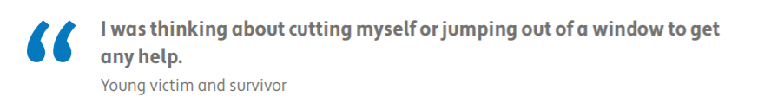
Case example
B age 14
Vaginal rape by peer 5 days earlier
Told admitting doctor after attendance to hospital following significant deliberate overdose
Need
Psychological distress
Opportunity
- Having a trusted adult

Slide 23
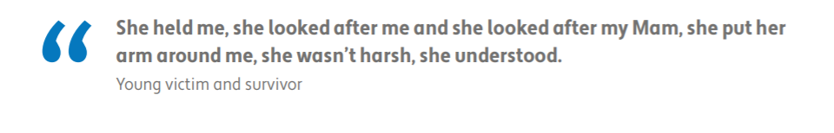
Case example
C age 4
Told mum about family friend ‘ stuck his bernard in my foo foo’, ‘it hurt a bit but I’m okay, I touched and some white stuff came out’
Need
Doesn’t apply as such EXCEPT need to share life, experiences with trusted adult (comes from previous positive parenting)
Opportunity
- Having a trusted adult

Slide 24
Case Example
D age 14
Tells grandmother about sexual abuse over 6 years (the last 2 months earlier) by grandfather after he is arrested for multiple offences against multiple other children and adults with learning difficulties
Need
Police investigation
Opportunity
- Being asked outright by grandmother and now feeling safe (suspect in custody/on bail)

Slide 25
Recognising potential signs and indicators of CSA

Slide 26
Children are more likely to show us than tell us
Children often show us rather than tell us that something is upsetting them
(Allnock, 2013)
Reflection…spend 5 minutes writing down the following:
How might a child or young person present given what we know about the impact of child sexual abuse?
Emotionally
Behaviourally
Physically
Think of as many as possible under each heading

Slide 27
Receiving and Responding to Disclosures
Notes:
I think the 2 slides about disclosure being a 2 way process are important to include in some way – to make the point about how we are as integral to the disclosure process as the child themselves – can we re-include those somehow? With different infographics if you don’t like the ones I’ve been using?

Slide 28
Preparing yourself for conversations with children?
Body language and facial expressions
Practice
When and where is a good time for this conversation?
Notes:
It won’t always be possible to prepare sometimes a child might start a conversation unexpectedly – especially common with younger children
But if you can you should take some time to consider:
Your body language and facial expressions
The demeanour of some professionals prevents or delays a child’s potential disclosure (Taskforce, 2010).
When and where is a good time for this conversation?
Actively listening, responding sensitively and creating a safe space for children to talk is crucial in breaking down barriers to disclosure (Allnock, 2010).
Can you use supervision or sessions with colleagues to practice ‘asking questions’

Slide 29
How can you ask?
‘I’ve noticed you’re not your usual self - is there anything you want to talk about?’
‘What is it that is upsetting you at the
he moment?’
‘Is there something I can do to help you tell me what is going on?’
‘Is there something going on that feels too hard to talk about?’
‘You don’t seem okay, would you like to tell me what is going on?’
‘Is there someone who you do feel able to tell?’
‘Sometimes we worry about what may happen if we tell someone what is going on (e.g. that we’ll get into trouble/that we’ve been told to keep it a secret/that we’ll upset people) – what is it that you are worried may happen if you tell someone what is going on?’
‘Seeing you upset has made me upset and it doesn’t feel nice at all. I want to help make those feelings better for you – what would you like me to do?

Slide 30
Helping children tell
Use Resources
I’m going to show you an online resource so that if there is something that is worrying you, you can work out how to get some help.
https://www.childline.org.uk/info-advice/bullying-abuse-safety/getting-help/asking-adult-help/#Writesomeonealetter
Give them time
I’m going to come and see you again next week and we can talk a bit more about this if you would like to.
Give them an alterative
Suggest a third person example and talk about that person. E.g. If you had a friend who was being hurt or touched in a way they didn’t’ like, what do you think would stop them telling? Or help them tell?
Help them understand their difficult feelings
The PANTS rule –
Is there anything that you feel worried about at the moment?”
If you were worried about something, who would you tell?
Depending on presenting concerns: Has anyone ever touched you on your private body parts (when you haven’t wanted them to), or asked you to touch them?

Slide 31
Responding to a Child's Disclosure of Abuse | NSPCC Learning - YouTube

Slide 32
Opening doors https://adc.bmj.com/content/106/2/108
If a child tells or shows, listen and attend carefully, even if you look like you are doing something else.
If you are not sure what the child said or did, or if you are not sure what they meant, offer an open invitation, for example, ‘tell me more about that’ or ‘show me that again’. Then say things like ‘uhuh’ or ‘mmhmm’ or ‘go on’ to show you are listening. These are safe things to say because they encourage the child to continue, without directing their account in any way.
Make it clear through your behaviour and body language that you are comfortable with the situation and that you have time.
Adapt your language and communication style in line with the child’s needs, being mindful of their developmental stage and age. Be clear about what you need to know.
Ask one open question at a time. Let the child or young person use his or her own words. Take your time, allow the child time to respond and pause between questions.
If appropriate, reflect back using the child’s own words. Say exactly what they said, without expanding or amending or asking questions. If appropriate, comment to show that you have noticed what a child is doing
Let the child know what you will do next. This can be very simple: ‘I am going to have a think and then I will come back’
Notes:
The opening doors approach can be applied to children who haven’t told (but there are concerns) but elements also work for just having good and open conversations with children and young people
Many children find it easier if eye contact is not demanded of them. Let the child tell you what they want to tell you, or show you what they want to show you, as long as they are safe.1 3

Slide 33
Opening doors: example
Becky appears anxious and wriggles a bit when on the examination couch. From the information you have already and from her presentation you are confident that Becky does not have a serious abdominal condition.:
Becky wriggles a bit and looks uncomfortable. You respond by giving Becky a quiet, fiddly toy but that risks closing the door. Instead, you might comment calmly, ‘you are a bit wriggly’ to open the door.
Becky then makes brief eye contact with you and pulls her jeans away from her genital area. You could then say, ‘are you sore down there?’ and Becky shakes her head. The door is closed.
Instead, you again comment calmly, ‘you are pulling your jeans’, to which Becky nods, then leans towards you and says quietly, ‘it’s so ouchy’.
You might then pause asking Becky’s mother to tell you about Becky’s ‘tummy pain’, at which point Becky looks away. Instead, you say, ‘uhuh’ and wait. Becky nods and says, ‘really ouchy down there’.
You could close the door by asking her mother if Becky has reported this to anyone; Becky’s mother says ‘no’, and Becky gets up and looks out the window. Instead, you open the door further by saying In the presence of a chaperone, ‘you said it’s really ouchy down there. Tell me more about that’. This is a very useful, open-ended question. Becky then says, ‘the mouse makes it ouchy’. You could then close the door by saying, ‘Do you mean a mouse like a pet mouse’, with Becky looking out the window in silence again; it would be better to open the door even further, with an enabling ‘uhuh, tell me more’.
Becky says, ‘Daddy’s mouse; it’s a secret but my bumbum is so ouchy’. It would be tempting to ask, ‘Has daddy touched you down there?’ Such a direct question will run the risk of closing the narrative and contaminating the evidence so, instead, you say, ‘You told me Daddy’s mouse. It’s a secret but your bumbum is so ouchy. Thank you for telling me this today Becky, it helps me understand why you may be getting tummy pains and how I can help you’. Becky nods and says, ‘in my bed; the mouse needs to come in the hole and play but it’s too big and it hurts me’.
That is sufficient narrative to warrant action without further questioning; you say, ‘thank you for telling me’.
Notes:
The opening doors approach can be applied to children who haven’t told (but there are concerns) but elements also work for just having good and open conversations with children and young people
Many children find it easier if eye contact is not demanded of them. Let the child tell you what they want to tell you, or show you what they want to show you, as long as they are safe.1 3

Slide 34
Activity
Notes:
As a group lets practice opening the door for a real life scenario – Ellis is 10 years old. When you say the right things then I will give you Ellis’ response

Slide 35
Grandad tickles my tummy sometimes
He does it in his van
Yeah, then he buys me McDonalds for being a
good girl
Yeah, he tickles me all the time, every time he takes
me in his van he tickles me
He tickles me here (points to vagina)

Slide 36
DfE (2015) Guidance on managing disclosures
“If a child reports, following a conversation you have initiated or otherwise, that they are being abused and neglected, you should listen to them, take their allegation seriously, and reassure them that you will take action to keep them safe.”
To ensure the safe handling of a disclosure from a child, there are a number of basic rules that should be followed:
Don’t panic – remain calm and reassuring in your manner.
Give the child your full attention to demonstrate you are listening carefully and taking the information seriously.
Let the child take their time, go at their own pace and use their own words.
Reassure them that they did the right thing by telling someone, and that they have been brave in doing so.
Assure them that it is not their fault and you will do your best to help.
Let them know that to, ensure they will be safe, you will need to tell someone else.
Let them know what you are going to do next and that you will let them know what happens.
Don’t make promises you can’t keep.
Choice and control

Slide 37
What to say and not say
Things to say: | Things NOT to say:
‘I believe you’ ‘I am going to try to help you’ ‘I am glad that you told me’ ‘You are not to blame’ ‘This is not your fault’ | ‘Why didn’t you tell anyone before?’ ‘I can’t believe that!’ ‘Are you sure that’s true?’ ‘Oh, that explains a lot’ ‘I won’t tell anyone else’ ‘Why? How? When? Where? Who?’

Slide 38
Summary

Slide 39
Summary – you can help break the silence
Recognise your role in the disclosure process
Disclosure is an ongoing process, of which you are a key part
Children are more likely to show us rather than tell us
Don’t see a lack of verbal disclosure as a reason not to intervene
Challenge our own and others’ assumptions
Think ‘what if I’m right’ not ‘what if I’m wrong’
Be brave
Be hopeful
Have confidence in our own skills
Practice

Slide 40
If you are affected by anything that is/has been discussed today…
The Bridge 0117 342 6999 http://www.thebridgecanhelp.org
The Survivors Trust
Find help, support and advice in your area: Survivors Trust directory of services.
Rape Crisis helpline – 0808 802 9999
www.rapecrisis.org.uk
National Association for People Abused in Childhood – 0808 801 0331
https://napac.org.uk/
SurvivorsUK
Online help for male survivors of sexual abuse and rape.
https://www.survivorsuk.org/ways-we-can-help/online-helpline/

Slide 41
Coming soon…https://www.csacentre.org.uk/
Communicating with children and signs and indicators resources

Slide 42
Thank you
Website: www.thebridgecanhelp.org
Email: ubh-tr.thebridgecanhelp@nhs.net
Or phone 0117 342 6999

