Slide 1
The MCA and 16-17 year olds
June 2019
Alex Ruck Keene
Barrister, 39 Essex Chambers
Wellcome Research Fellow and Visiting Lecturer King’s College London
Visiting Senior Lecturer, Institute of Psychiatry, Psychology and Neuroscience, King’s College London
Research Affiliate, Essex Autonomy Project, University of Essex
alex.ruckkeene@39essex.com
@capacitylaw

Slide 2
Caveat: everything that follows is to be read subject to what the Supreme Court says in Re D: judgment still awaited

Slide 3
The starting point
MCA 2005 applies to 16/17 year olds in the same way that it does to adults except:
Cannot make advance decision to refuse treatment (but could make advance statement)
Cannot grant power of attorney (or be an attorney)
Cannot make statutory will
Other legislation also differentiates between 16/17 year olds and those over 18 – e.g. marriage / voting

Slide 4
Wild cards (1): Gillick or the MCA
Is the test Gillick competence or s.2 MCA post-16?
Gillick competence and s.2 coming closer together (see e.g. Re S (Child as parent: Adoption: Consent) [2017] EWHC 2729 (Fam)), but still different tests
No presumption of Gillick competence
No requirement that inability to make decision caused by impairment or disturbance in the functioning of the mind or brain
General understanding that s.2, but thrown into doubt by Re D [2017] EWCA Civ 1695

Slide 5
Wild cards (2): the ‘overwhelmed’ child
16/17 year old unable to make decision, but not because of MCA impairment/disturbance
A category identified in guidance (e.g. MCA and MHA Codes of Practice) but not in case-law
Two questions
Do they really exist, bearing in mind s.1(3) MCA support principle?
How do they differ from the ‘vulnerable adult’ identified for purposes of the inherent jurisdiction: Re DL “an adult whose autonomy has been compromised by a reason other than mental incapacity because they are … (a) under constraint; or (b) subject to coercion or undue influence; or (c) for some other reason deprived of the capacity to make the relevant decision or disabled from making a free choice, or incapacitated or disabled from giving or expressing a real and genuine consent”?

Slide 6
Pop quiz: best interests or PR?
Where child unable to consent to relevant act, and there is a person with ‘true’ PR (i.e. not local authority under e.g. care order) do you?
Seek consent from the parent?
Following best interests decision-making process under MCA?
Does it make a difference?

Slide 7
The limits of PR (1) deprivation of liberty
Re D: person ‘true’ PR (but not LA) can consent to confinement of 16/17 year old lacking Gillick competence if within ‘ordinary acceptable parental restrictions’
LA can never consent Re A-F (No 1) [2018] EWHC 138 (Fam)
Case before Supreme Court at the moment
LPS will when implemented apply to 16+ where lack capacity applying MCA test

Slide 8
The limits of PR (2) treatment
No need even to consider PR where 16/17 year old has capacity and is consenting:
To surgical, medical or dental treatment (s.8 Family Law Reform Act 1969)
To admission as informal patient under MHA 1983 (s.131 MHA 1983)
Admission/treatment as informal patient under MHA 1983
Cannot override capacitous refusal of 16/17 year old: s.131 MHA 1983
MHA Codes of Practice (rightly) caution against reliance even where 16/17 year old lacks capacity
Overriding refusal of capacitous (or competent) 16/17 year old to consent to medical treatment
Suggest need to go to court
The one true area of difference between 16/17 year olds and those over 18
Treating in the face of objection by 16/17 year lacking capacity (or competence) to consent to medical treatment
Suggest need to go to court in the same circumstances as you would for adult lacking capacity

Slide 9
Which court? (1)
Family Court for Children Act matters
High Court (Family Division) inherent jurisdiction
Medical treatment
Confinement Re A-F (No 1) [2018] EWHC 138 (Fam) and (2) [2018] EWHC 2129 (Fam)
Nb real judicial edginess about use of inherent jurisdiction to circumvent s.25 Children Act 1989 Re T (A Child) [2018] EWCA Civ 2136
Court of Protection
Welfare
Medical treatment
Confinement – COPDOL11

Slide 10
Which court? (2)
High Court/Family Court or Court of Protection? The factors
One, is the child over 16? Otherwise of course, there is no power. Two, does the child manifestly lack capacity in respect of the principal decisions which are to be made in the Children Act proceedings? Three, are the disabilities which give rise to lack of capacity lifelong or at least long-term? Four, can the decisions which arise in respect of the child's welfare all be taken and all issues resolved during the child's minority? Five, does the Court of Protection have powers or procedures more appropriate to the resolution of outstanding issues than are available under the Children Act? Six, can the child's welfare needs be fully met by the exercise of Court of Protection powers? These provisional thoughts are intended to put some flesh on to the provisions of Article 3(3); no doubt, other issues will arise in other cases. The essential thrust, however, is whether looking at the individual needs of the specific young person, it can be said that their welfare will be better safeguarded within the Court of Protection than it would be under the Children Act.
B (A Local Authority) v RM & Ors [2010] EWHC 3802 (Fam) (15 October 2010)

Slide 11
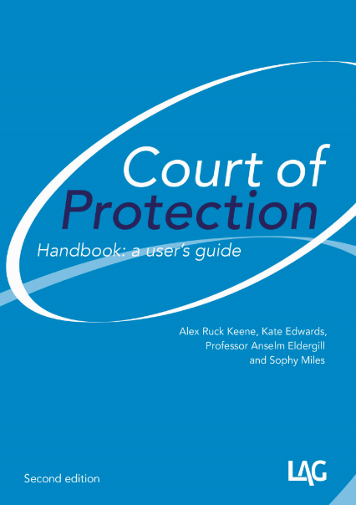
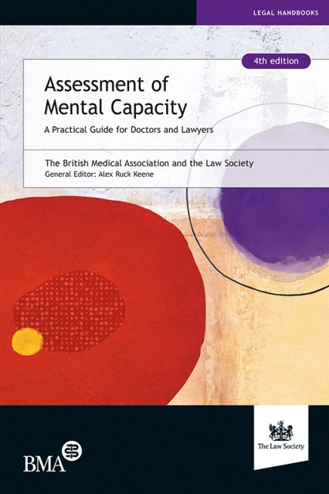
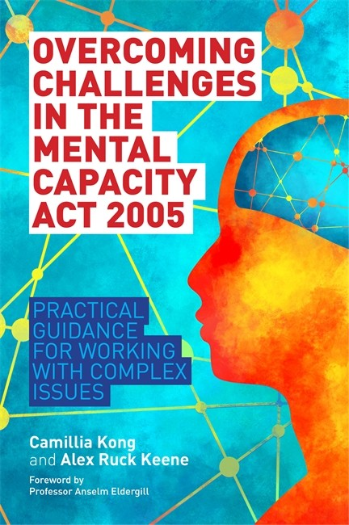
Keeping yourself up-to-date
http://www.39essex.com/resources-and-training/mental-capacity-law/
http://www.scie.org.uk/mca-directory/
www.mclap.org.uk
www.mentalhealthlaw.co.uk
www.courtofprotectionhandbook.com

