Slide 1
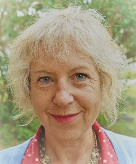



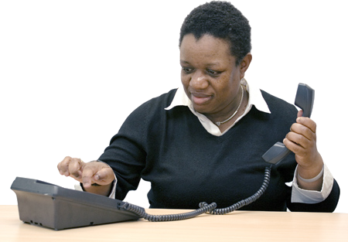
Disability Hate Crime
Sarah Howard
Team Leader
0746 467 0364
sarah.howard@brandontrust.org
In an emergency, call the police on 999
Non-emergency, call 101
Call 112 if you have no signal

Slide 2
Bristol Hate Crime & Discrimination Service
A collaboration of:
Partnership working includes:
Case management
Training
Awareness Raising
Disability Working Group
Mediation & RJ
Provider Forum
Service User Forum
BDEF (Bristol Disability Equality Forum)
DIAG (Disability Independent Adv. Grp)
Discrimination
National Compact Award

Slide 3
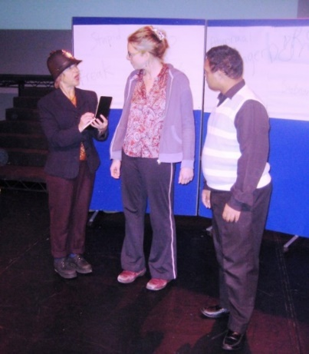
Training
How to identify and report disability hate crime
For disabled people and professionals
Drama presentations for events
Disability Equality Awareness
Disability hate crime workshops

Slide 4
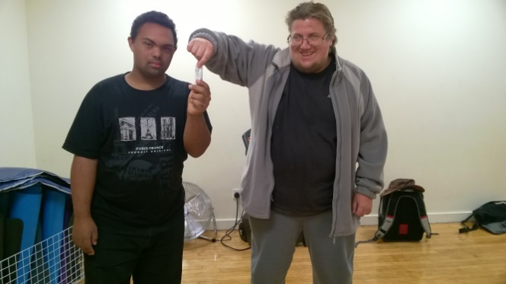
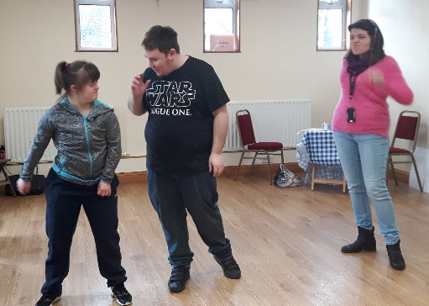
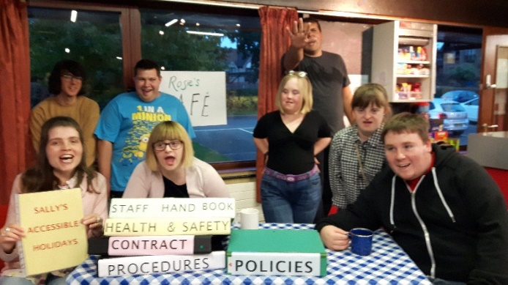
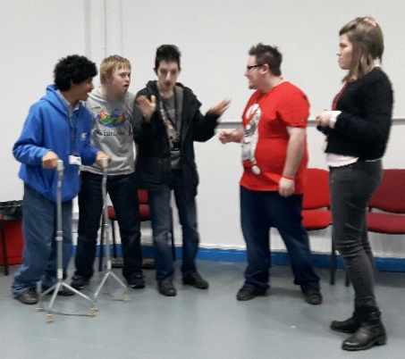
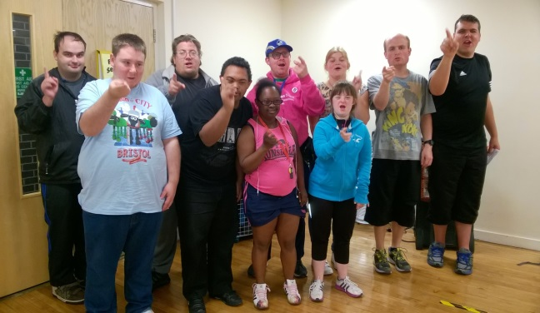

Training Workshops

Slide 5
Bristol Hate Crime & Discrimination Service
Freephone: 0800 171 2272
 www.sariweb.org.uk
Sarah Howard
sarah.howard@brandontrust.org
0746 467 0364
In an emergency, call the police on 999
Non-emergency, call 101
Call 112 if you have no signal

