Slide 1


Modern Slavery Overview
Rachel Collins-White Daniel Douglas
r.collins-white@unseenuk.org d.douglas@unseenuk.org
Copyright © 2017 Unseen
Notes:
Rachel to lead
Introduce yourself
(ensure this slide is updated with the trainer’s name and email address)
Explain the format for the session:
First half looking at the issue of trafficking and slavery
Second half looking at the technical details including the Modern Slavery Act and the governments system to identify and provide support for potential victims.
Explain that we have/will arrange for slides to be sent via email, so you will get a copy of everything you see on screen, but if you want to take additional notes, please do. This is our standard practice in order to save paper
National Occupational Standards: SFJBMS01, SFJBMS02, SFJBMS03, SFJBMS04

Slide 2
Working towards a world without slavery;
Supporting survivors and potential victims of slavery; by providing access to a range of specialist services, enabling them to safely recover and develop resilient independent lives
Equipping stakeholders; by providing training, advice and resources to facilitate the identification and support of potential victims of slavery
Influencing systemic changes; by using our experience and research to impact and inspire transformation across legislation, policy and society.
Copyright © 2016 Unseen
Notes:
Rachel to lead
Unseen was establish in 2008.
We focus on three main areas as we work towards a world without slavery;
Go through the frontline services we offer –
RIO: Outreach and resettlement service for survivors who have been granted status and need support to settle in their new communities (65 people through service, currently 25 men and women across A&S working with)
WATER: 24/7 staff secure project for women who have been trafficked (referrals from a central mechanism) 8 units, worked with over 115 women in 4 years.
CHIPS, Mens project – to replicate WATER
Anti-Slavery Partnership – multi-agency local and regional partnership with NCA, UKHTC, Police, third sector, DWP, HMRC – work out how to tackle slavery, proactively look for it, get victims to safety and bring perpetrators to justice LINK TO THE VISITS

Slide 3
Trafficking is the movement of people by means such as force, fraud, coercion or deception with the aim of exploiting them.
It is modern day SLAVERY
Copyright © 2016 Unseen
Notes:
EXPLAIN:
Trafficking is the commodification of people for the purpose of making money and profit. These are astute business men and women, it is very profitable. Compared to drugs which you can sell once, people can be sold over and over again.
Trafficking breaks down into 3 elements:
The act (what is done) – recruiting, transportation, transfer, harbouring or receipt of persons
The Means (how it is done) – force, fraud, coercion, deception (element not required for child trafficking)
The purpose (why it is done) – exploitation
There is NO requirement for the purpose to have been achieved, so a person who escapes before exploitation has occurred can still be a victim of trafficking
MYTH BUSTING:
Not only crime against foreign nationals
Doesn’t have to include the crossing of an international border
Modern Slavery is not the same as people smuggling. Modern Slavery is an offence against a person. Smuggling is an offence against the state – the illegal entry into a country

Slide 4
Someone is in slavery if they are:
forced to work - through mental or physical threat
owned or controlled by an 'employer', usually through mental or physical abuse or the threat of abuse
dehumanised, treated as a commodity or bought and sold as 'property'
physically constrained or has restrictions placed on his/her freedom
Copyright © 2016 Unseen
Notes:
The government's response provides useful definitions which are encompassed within the term 'modern slavery' for the purposes of the Modern Slavery Act 2015.
These are:
'slavery' is where ownership is exercised over a person
'servitude' involves the obligation to provide services imposed by coercion
'forced or compulsory labour' involves work or service extracted from any person under the menace of a penalty and for which the person has not offered himself voluntarily
'human trafficking' concerns arranging or facilitating the travel of another with a view to exploiting them.

Slide 5
Types of Slavery
Sexual Exploitation
Domestic Servitude
Forced Labour
Debt Bondage
Organ Harvesting
Criminal Exploitation
Child Trafficking
Notes:
Rachel
EXPLAIN:
Sexual Exploitation: The forcible or deceptive recruitment of women, men and children, for the purposes of forced prostitution or sexual exploitation.
Domestic Servitude: Employment in private homes where victims are ill treated, humiliated and subjected to exhausting working hours and other exploitation.
Forced Labour: Is any work or services which people are forced to do against their will under the threat of some form punishment.
Debt Bondage: Victims are forced to work to pay off debts that realistically they never will be able to. Low wages and increased debts mean not only that they cannot ever hope to pay off the loan. Terms and conditions of work often change and victims become trapped.
Organ Harvesters: Traffickers force or deceive the victims into giving up an organ. Cases where victims formally or informally agree to sell an organ and are cheated because they are not paid for the organ or are paid less than the promised price. Vulnerable persons are treated for an ailment, which may or may not exist and thereupon organs are removed without the victim's knowledge
Criminal Expolitation: Often controlled and maltreated, victims are forced into crimes such as cannabis cultivation, pick pocketing, forced begging, charity collection bags against their will.
EXAMPLES:
Domestic Servitude: Lady working in London. Was found having had a heart attack on the street. She had been working for one family for over 40 years being sent backwards and forwards between here and their home country. She had been mal treated throughout her life and had recently been replaced by a ‘newer model’
Forced Labour: Happy Eggs, 2012. Gangmaster company which provided teams of migrant workers to brands including Happy Eggs. 30 Lithuanian workers were alleged to have been trafficked in to the UK. Kept in debt bondage, forced to work up to 17 hours a shift, bussed to farms, to catch hens through the night, sleeping sometimes only in vans, in some weeks not paid at all, and kept with threats of violence and some actual physical assault.
Debt Bondage: one guy working in a car wash, agreed arrangement for travel but then offer £60 upon arrival for food and cigarettes. Wasn’t getting paid in order to ‘recover this debt’.
Criminal Exploitation: Gentleman exploiting 15 Slovaks, they had all signed on with the job centre and were being paid benefits/allowance, all into the exploiters bank account. All being dropped off and picked up in a white van once a week.

Slide 6


Numbers based on type of exploitation
Notes:
Rachel
EXPLAIN:
These statistics on the next few slides are the 2017 stats:
Total: 5148 (adults and children) 5148
Government released estimates of 10-13,000 in 2014. The discrepancy between the two numbers is due to the National Referral Mechanism Process. We believe these numbers are just the tip of the iceberg. They only represent those victims found, correctly identify, offered and accepted help!
Domestic Servitude 488
Labour Exploitation 2327 – 45% of all victims
Organ Harvesting 4
Sexual Exploitation 1741 – 34% of all victims
Unknown Exploitation 589
2455 (48%) were Women
2690 (52%) were Men
3 (0.5%) were transgender
20.9 million people trapped in labour exploitation ILO
45.8 million people in slavery worldwide according to the Global Slavery Index, 2016
Human trafficking is the second largest illegal trade in the world and it is the fastest growing international crime
Forced labour in the private economy is worth an estimated $150 billion profits world wide (International Labour Organisation 2014).

Slide 7
Where people came from
Notes:
Compare this slide to the group work.
Offer commentary on reflections where appropriate.
EXPLAIN:
74% of all victims came from the top 10 countries.
Figures can fluctuate dependant on what organisations are taking note of or pursuing. For example, it is known that slavery can be found in Vietnamese nail bars or Albanian car washes, so police have been more vigilant in these areas.
In recent years statistics have possibly been skewed by big cases such as Rochdale in the UK – however, we have also seen 5 British women through our project in 2016 and we had seen none before that.
Note: a lot of recorded victims were here legally – EEA nationals, legally able to reside and work in the UK
Explain that of those 820 UK victims 677 were minors Under the age of 18 years old.
Compare this slide to the group work.
Offer commentary on reflections where appropriate.
PREVIOUS STATISTICS (2016):
Albania
Vietnam
UK
Nigeria
China
Romania
Poland
Eritrea
India
Afganistan

Slide 8
Statutory Duty to Notify
(Modern Slavery Act 2015)
Certain frontline staff who encounter a potential victim of modern slavery are required to notify the Home Office under Section 52 of the Modern Slavery Act
https://www.gov.uk/government/publications/duty-to-notify-the-home-office-of-potential-victims-of-modern-slavery
Notes:
Dan
ASK: (For statutory agencies only -assess current knowledge)
Who is aware of their statutory duty? Do you know if you are a First Responder?
This duty is 2 fold:
1: Allow those who consent and want help to enter the NRM system and access help they need
2. Help the government build a clearer picture of what is happening – by filling in the statutory duty to notify form.
EXPLAIN:
Trying to address the disparity between the 5148 recorded and the 10-13,000 estimated victims
Collating more data, in order to ask questions and address the problem.
This should be completed if you come across a victim of trafficking or slavery
DUTY for statutory agencies/VOLUNTARY for non-statutory agencies
PROCESS:
There is a form to complete which is available on our website or the Home Office website
The “duty to notify” is set out in Section 52 of the Modern Slavery Act 2015, and applies to the following public authorities in England and Wales at the time of publication (additional public authorities can be added through regulations):
(a) a chief officer of police for a police area
(b) the chief constable of the British Transport Police Force
(c) the National Crime Agency
(d) a county council
(e) a county borough council
(f) a district council
(g) a London borough council
(h) the Greater London Authority
(i) the Common Council of the City of London
(j) the Council of the Isles of Scilly
(k) the Gangmasters Licensing Authority
https://www.gov.uk/government/publications/duty-to-notify-the-home-office-of-potential-victims-of-modern-slavery
A duty to notify referral should not be relied upon to safeguard victims. Existing safeguarding processes should still be followed in tandem with a notification
SLOW TIME FORM – DATA COLLATION

Slide 9
The National Referral Mechanism
(NRM)
Framework used to identify victims and collate data
Used to provide appropriate support and protection (via Salvation Army)
Grants a minimum 45-day reflection and recovery period during the process – with access to counselling, housing, finance, legal advice
Any one can identify a potential victim but referrals into this mechanism must be made by First Responders
Notes:
Rachel
EXPLAIN: Point out that this is currently under review
The contract held by the Salvation Army is up for renewal in 2020, Unseen are working closely with the HomeOffice to give them the knowledgeand experience we have working with Victims unde the current System.
Victim Services: The National Referral Mechanism (NRM) is a framework for identifying victims of human trafficking and ensuring they receive the appropriate protection and support.
Statistics Collection: The NRM is also the mechanism through which the UKHTC collects data about victims. This information contributes to building a clearer picture about the scope of human trafficking in the UK.
The NRM was introduced in 2009 to meet the UK’s obligations under the Council of European Convention on Action against Trafficking in Human Beings. At the core of every country’s NRM is the process of locating and identifying “potential victims of trafficking” (PVoT). This requires 30 days but our government has required 45 days.
The NRM grants a minimum 45-day reflection and recovery period for victims of human trafficking. Trained case owners decide whether individuals referred to them should be considered to be victims of trafficking according to the definition in the Council of Europe Convention – a reasonable grounds decision.
Its important to note here for some people 90 days will be too long, for others it won’t ne enough. If we only focus on how many days victims are able to be in the NRM then we aren’t focusing on the important thing – the victim as a person.

Slide 10
The National Referral Mechanism
Through the NRM, if they want to leave their situation, they will be able to access:
  Temporary safe accommodation
  Support worker (in accommodation or as outreach)
  Medical treatment
  Help to cope with experience
  Interpreters
  Assistance finding independent legal advice
  Via The Salvation Army Adult Care Contract 0300 3038151
Notes:
EXPLAIN:
The contract held by the Salvation Army is up for renewal in 2020, Unseen are working closely with the Home Office to give them the knowledge and experience we have working with Victims unde the current System.
The Salvation Army hold the government contract funded by the Home Office to provide support to PVoT whilst in the NRM – 11 subcontractors across the UK providing services. Outside of the NRM, very few services available.
You can tell PVoT this but they will only be able to access if they enter the NRM and get a reasonable grounds decision.

Slide 11
Reasonable Ground Decision
Conclusive Grounds Decision
Identification
(First Responders)
Referral
(First Responders)
Support
Contract
Modern Slavery and Human Trafficking Unit
(UK, EU & EEA)
Modern Slavery and Human Trafficking Unit
(UK, EU & EEA)
Home Office
(42% of Cases)
Reasonable Grounds
Conclusive Grounds
Police
(25% of Cases)
Non-Governmental Organisations
(21% of Cases)
Referral
Care
Exit
Local Authority
(9% of Cases)
UK Visas and Immigration
(Non EEA)
UK Visas and Immigration
(Non EEA)
National Crime Agency
(2% of Cases)
Reasonable Grounds
Conclusive Grounds
Gangmasters and Labour Abuse Authroity
(1% of Cases)
Notes:
PROCESS:
To be referred to the NRM, potential victims of trafficking must first be referred to one of the UK’s two competent authorities (CAs: UKVI or UKHTC). This initial referral will be handled by an authorised agency (a First Responder) such as a Police force, the UK Border Force, Home Office Immigration and Visas, Social Services or certain NGOs
UKVI if outside the UK, EU or EEA
UKHTC if inside the UK, EU or EEA
The CAs will initially make a Reasonable Grounds decision (RG) which will allow the PVoT to access help and support (The Salvation Army Provision) for a minimum of 90 days. This can take up to 5 days. (If a PVoT is in a dangerous and vulnerable situation the CAs and TSA may well move quicker than 5 days!)
The CAs will then follow this up with a Conclusive Grounds decision (CG). If negative, support must end within 48 hours.
EXPLAIN:
This can be a slow process, can take a number of hours (language barriers, fear, lack of trust)
This is only a temporary solution, very short term (minimum 90 days)
This may require a move to somewhere else in the country, but they might not need to move as there is an outreach arm of the service so people can stay where they are if they want to, and still access support.
The NRM will require their consent (signature)
Consider translation (Language Line)
Explain that this is a system people can access, although not perfect.
Consider any planned visits, if you have a suspicion you may come across PVoTs you could pre-warn TSA or your First Responder
PROCESS RECAP:
Meet a PVoT
Explain to them what is available to them, what the process is
Ensure the PVoT is completely informed – available services are only short term and no guarantees at the end, you may be housed anywhere in the country, may not be accepted
Complete an NRM form with First Responder and PVoTs signature, submit to CA.
Call Salvation Army, they will risk assess and then arrange a placement
For reference – from the NCA website:
To be referred to the NRM, potential victims of trafficking or modern slavery must first be referred to one of the UK’s two competent authorities (CAs). This initial referral will generally be handled by an authorised agency such as a police force, the NCA, the UK Border Force, Home Office Immigration and Visas, Social Services or certain NGO’s. The referring authority is known as the ‘first responder’.
The NCA is a first responder agency, as are the following:
Police forces
UK Border Force
Home Office Immigration and Visas
Gangmasters Licensing Authority
Local Authorities
Health and Social Care Trusts (Northern Ireland)
Salvation Army
Poppy Project
Migrant Help
Medaille Trust
Kalayaan
Barnardos
Unseen
TARA Project (Scotland)
NSPCC (CTAC)
BAWSO
New Pathways
Refugee Council

Slide 12
Barriers victims may face
Language barriers Cultural and Religious barriers Voodoo and Spiritual practices Stockholm Syndrome Threats to self Threats to family Debt bondage | Family implicit in their exploitation Learning difficulties System not offering them assistance Time Trust Shame and guilt Immigration status
Notes:
Explain:
Often stories change, people appear awkward, wary of engaging:
This is not always them trying to be obstructive but can be as a result of trauma, threats to family or the story they have been told to tell.
Potential victims of modern slavery may: be reluctant to come forward with information, not recognise themselves as having been trafficked or enslaved, tell their stories with obvious errors
It is not uncommon for traffickers or modern slavery facilitators to provide stories for victims to tell if approached by the authorities. Errors or lack of reality may be because their initial stories are composed by others and learnt.
Victims’ early accounts may also be affected by the impact of trauma. In particular, victims may experience post traumatic stress disorder, which can result in the following symptoms:
hostility
aggression
difficulty in recalling details or entire episodes
difficulty concentrating
Victims perspective
May be a better quality of life than they are used to
This may be normal for them
Unlikely to call themselves a PVoT
Might not realise it is wrong/exploitative
Risks to their family/others not in the UK
Risks to themselves
May not trust the authorities (eg Police)
Fear of immigration status: they may have been lied to about their status in the UK, or about how government officials and police will treat them. This can also be part of the reluctance to sign the NRM form.
EXAMPLES:
Remember that girl we talked about earlier who fell in love with the wrong man? That lady was intelligent (due to study a masters degree) and had been deceived by her ‘boyfriend’. She suffered with a lot of guilt and shame, embarrassment about what had happened and not feeling worthy of help and support.
Threats to family is something we may not be able to help with. One lady we worked with had managed to leave her situation of exploitation with help from the police but the traffickers then went back to her home, burnt down her family business, broke her brothers legs and threatened her sister – demonstrate reluctance victims through family ties.

Slide 13
Next Steps…
Inform yourself – what am I looking out for? What are the alarm bells for my role and who do I go to if concerned?
Identify key risk areas and vulnerabilities in your team/organisation – where might you encounter people
What are your organisational policy’s and statutory duties
Notes:
Rachel
EXPLAIN:
Encourage internal conversations within departments
Information sharing
Safeguarding/reporting pathways – do your officers know what to look for and how to report it?
Reporting intelligence (101)
Whose responsibility within area to ensure statutory duties are met
When they are on visits are they looking for key signs?
Is there the correct safety equipment clothing in place?
Are there signs of people living and working in the same place?
What are the signs to look for and how do they report it.
We have worked with EHO before to develop pro forma’s for officers to take along to visits to prompt them. We can help with training, etc

Slide 14
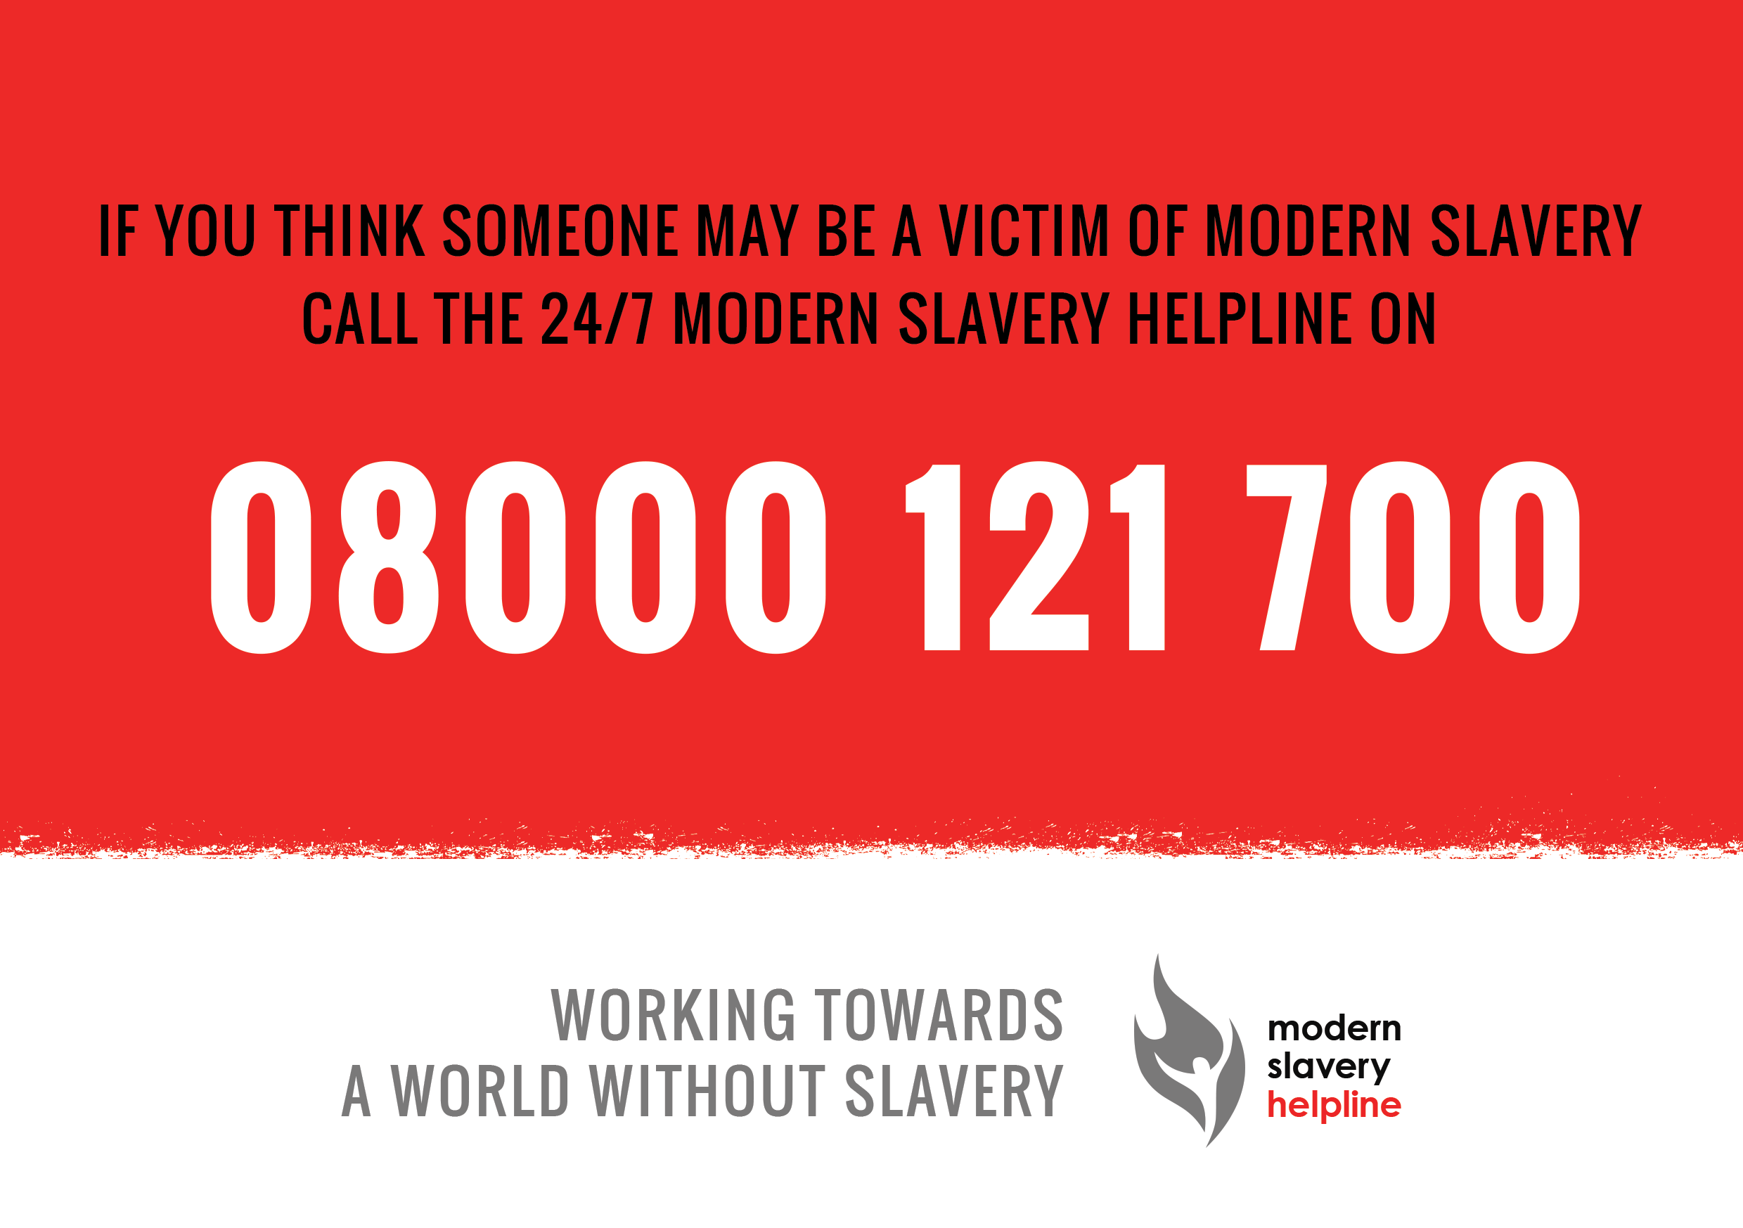
Notes:
Dan
OPTIONAL
National Modern Slavery Helpline and Resource Centre.
Opened in October 2016 and being operated by Unseen.
24/7/365 service for the UK
Highly trained individuals ready to take calls
You can call if you are:
a victim of slavery or trafficking, or think that you might be
a frontline professional looking for advice about a specific case you might be dealing with
a business concerned about slavery in supply chains or an element of business practice
a member of the public wanting to discuss a concern
You can also submit a contact form through the website www.modernslaveryhelpline.org
Statistics of the calls being made to the Helpline can be found on the modern slavery helpline website.

Slide 15
Any questions?
Copyright © 2016 Unseen

